Slide 1
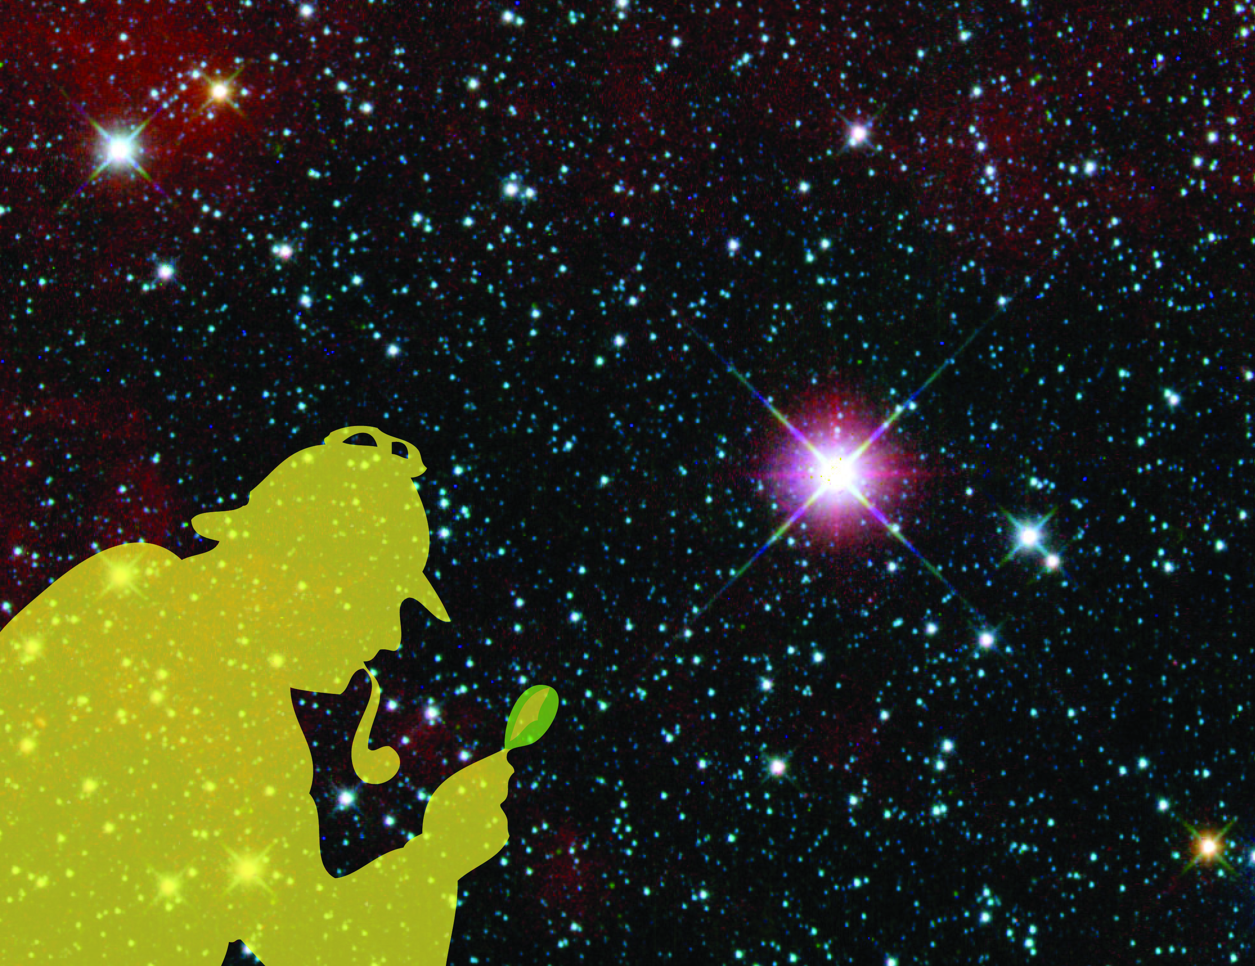
Light Detectives
Light Detectives
Using NASA’s WISE Data to Identify Brown Dwarfs and ULIRGs
Notes:
Introductory slide

Slide 2
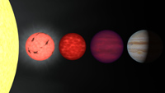
Brown dwarfs
Limb of Sun
Brown dwarf
Brown dwarf
Very low mass star
Jupiter
Light Detectives – #2
Notes:
Tell students the definition of a brown dwarf: A brown dwarf is an astronomical object that, when it was formed, did not quite have the mass necessary to become a star. Brown dwarfs are too large to be planets and too small to be stars. Slide #2 shows the size of typical brown dwarfs compared to that of typical stars and the planet Jupiter.
The masses of brown dwarfs range from about 13 times the mass of Jupiter to about 80 times the mass of Jupiter. Objects less massive than 13 times the mass of Jupiter would be classified as giant planets; objects more massive than 80 times the mass of Jupiter probably fuse hydrogen and would be called stars. Brown dwarfs are one kind of object that the new WISE mission is searching for.
An artist's rendition comparing stars, brown dwarfs, and planets to the same size scale. From left to right is the limb of the Sun, a very low mass star, a pair of brown dwarfs, and the planet Jupiter. These objects have masses ranging from 1000 times that of Jupiter (for the Sun) through 75, 65, 30, and 1 Jupiter mass, respectively.

Slide 3
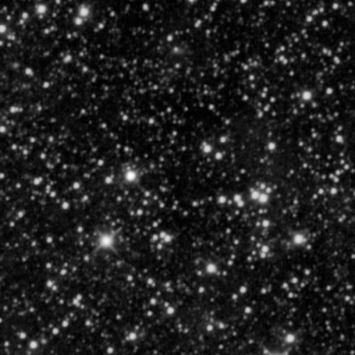
Where is the brown dwarf?
Light Detectives – #3
Notes:
Show students this WISE image, and ask them if they can find the brown dwarf (they won’t be able to) called WISE 1828+2650, the coldest brown dwarf known. Raw data – or the images astronomers receive before they are processed – have lots of information that may be difficult to interpret by eye.

Slide 4
How do astronomers
know what they know?
Regular Stars
Brown Dwarfs
(more green [W2], less blue [W1])
Light Detectives – #4
Notes:
One of the ways astronomers identify and learn about celestial objects is to measure their color. The characteristic wavelengths of light associated with a star, for instance, depend on the specific physical and chemical processes that take place within and around that star. Color is the ratio of two different wavelengths of light associated with a celestial object. The WISE mission takes images of the sky in four wavelengths of infrared light: 3.4 μm (microns), 4.6 μm, 12 μm, and 22 μm. We refer to these as the W1, W2, W3, and W4 bands. Light in the W1 band is typically designated blue, the W2 band green, and the W3 band red. Since brown dwarfs are relatively deficient in W1 (3.4 μm) light and relatively bright in W2 (4.6 μm) light, they appear very green in color images.

Slide 5
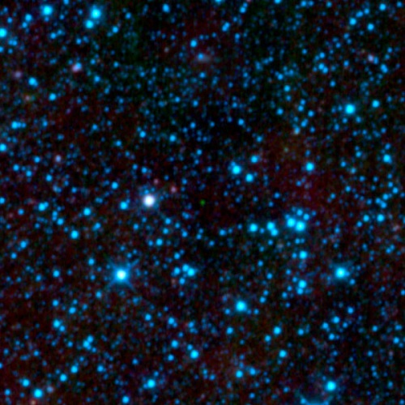
Where is the brown dwarf?
Light Detectives – #5
Notes:
The image on this slide is a combined representational-color image of the same part of the sky as the previous slide (#4). Light in the W1 band is designated blue, the W2 band green, and the W3 band red. Based on this information, as well as the previous slide, ask your students if they can now identify the brown dwarf in the image.

Slide 6
Light Detectives – #6
Notes:
The arrow indicates where the brown dwarf is.

Slide 7
Let’s find a brown dwarf more scientifically using real NASA data
The Process:
Find and download the data
Make measurements
Plot and interpret the results
Light Detectives – #7
Notes:
In order to find out detailed information about lots of stars and brown dwarfs, astronomers have had to develop techniques for precisely measuring their light. Photometry is the technique of measuring a celestial object’s brightness or intensity – the amount of light in a given wavelength. In the following section, students will use the computer program SalsaJ to systematically measure the intensity of stars and brown dwarfs.
Leave this slide up until the students have downloaded their images.

Slide 8
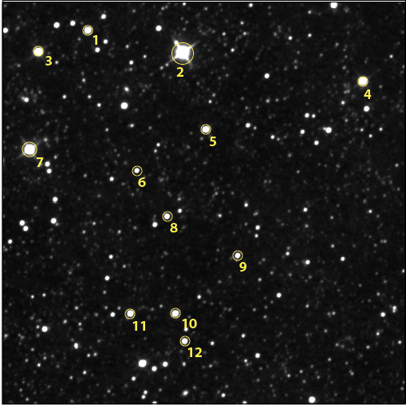
Finder Chart
A finder chart shows you where to find objects in the sky.
The same objects will appear in each of the WISE images you download.
Light Detectives – #8
Notes:
Discuss the talking points on the slide. Tell your students that a finder chart shows them how to locate the objects they will measure. The numbers are arbitrary. The same targets appear in each of the three images they will analyze. Leave this slide up while the students complete the next section.

Slide 9
How do astronomers
know what they know?
Regular Stars
Brown Dwarfs
(more green [W2], less blue [W1])
Light Detectives – #9
Notes:
This is the exact same slide as before (#4). Ask the students to study the slide, especially the ratio of green to blue (W2/W1) and the ratio of red to green (W3/W2), and see if they can guess which of 12 objects they plotted is a brown dwarf (only one of them is).

Slide 10
Light Detectives – #10
Notes:
The students color-color diagrams should look roughly like this one. Ask which object has the highest W2/W1 ratio? Which object has the highest W3/W2 ratio?
…The answer is object #6! That is a brown dwarf!

Slide 11
Color-Color Diagram
5 4 3 2 1 0
Brown dwarfs have LOW intensity in W1.
Brown dwarfs are relatively BRIGHT in W2 light.
What objects have high W2/W1 ratios?
What objects have higher W3/W2 ratios than brown dwarfs?
AGB Stars
W2/W1
Brown Dwarfs
ULIRGs
Stars
Normal Galaxies
0 1 2 3 4 5 6 7 8 9
W3/W2
Light Detectives – #11
Notes:
This slide shows the regions on the color-color diagram where different classes of objects detected by WISE would fall. Notice that although both brown dwarfs and a class of stars known as asymptotic giant branch (AGB) stars have high W2/W1 ratios, the two classes of objects can be distinguished because we can also compare their W3/W2 ratios. Though the regions have some overlap, AGB stars tend to have much higher W3/W2 ratios than brown dwarfs.
Brown dwarfs are noted for having an absorption line near the W1 (3.4 μm) wavelength. That means that due to the chemical composition of the brown dwarf, it absorbs light with wavelengths near 3.4 μm, and the intensity in that wavelength tends to be unusually low. This means that the ratio of the 4.6 μm intensity to the 3.4 μm intensity (W2/W1) will tend to be high in comparison to other objects, which will have smaller values.
However, brown dwarfs are not the only objects that might have 4.6 μm to 3.4 μm (W2/W1) ratios in that high range. Certain giant stars or dusty galaxies may also have similar ratios (or “color” as astronomers use the term). To separate out those objects we can look at the intensity ratio between 12 μm and 4.6 μm (W3/W2). Brown dwarfs and stars will tend to have smaller flux ratios compared to the dusty galaxies and red giant stars.
Thus, brown dwarfs will tend to be higher on the color-color diagram than normal stars. Since dusty galaxies such as ULIRGs emit lots of light in the W3 band due to warm dust, their W3/W2 ratios are high, and they tend to be farther to the right of brown dwarfs on the color-color diagram.

Slide 12
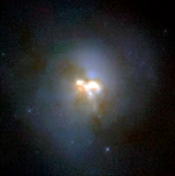
ULIRGs
Ultra-Luminous Infrared Galaxies
Light Detectives – #12
Notes:
Tell students what a ULIRG is: An Ultra-Luminous Infrared Galaxy (ULIRG) is a type of galaxy that is a 100 times more luminous in infrared light than it is in visible light.

Slide 13
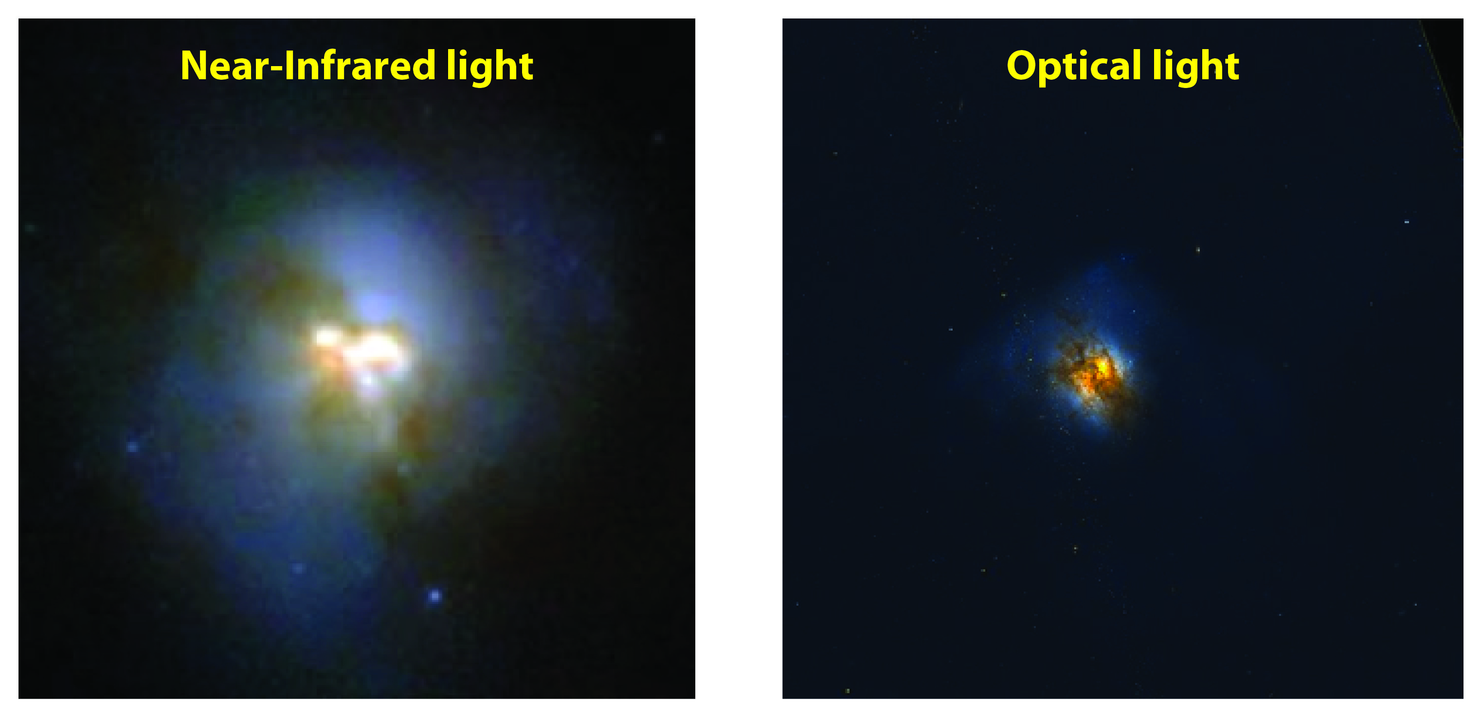
Arp 220
Light Detectives – #13
Notes:
Compare and discuss the near-infrared and optical images of the ULIRG Arp 220. Much of the infrared light of ULIRGs comes from warm dust associated with star formation (left). However, dust blocks light at optical wavelengths, but stars emit a large part of their energy in the optical, and so in an optical image of Arp 220, the structure of the galaxy’s stars and dust lanes are prominent (right).

Slide 14
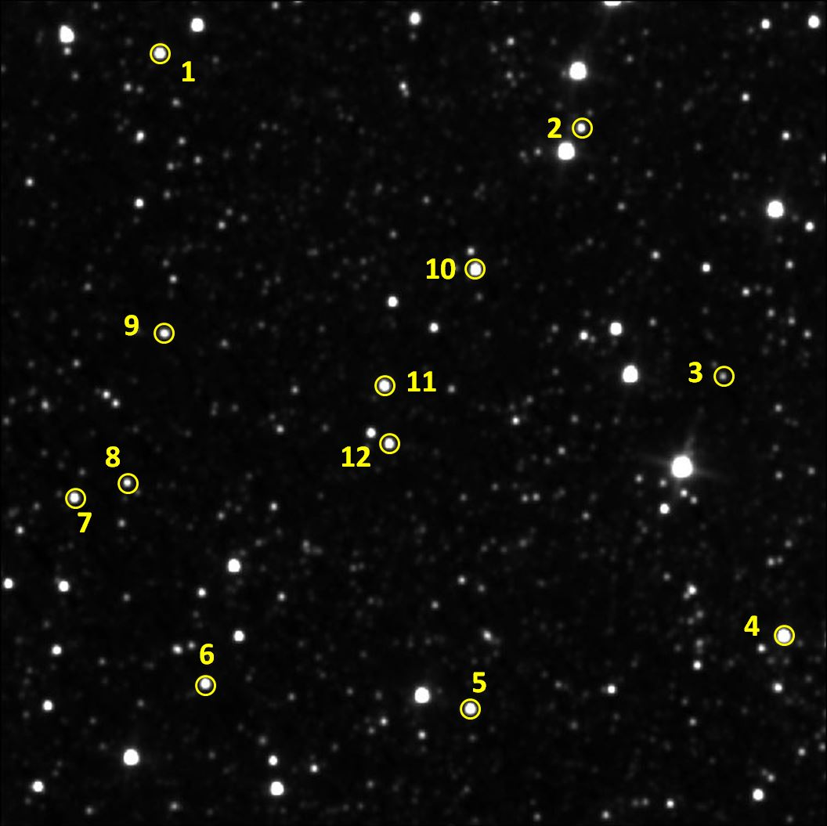
Finder Chart
A finder chart shows you where to find objects in the sky.
The same objects will appear in each of the WISE images you download.
Light Detectives – #14
Notes:
Finder chart for the Going Further (ULIRG) section of the activity.

Slide 15
Light Detectives – #15
Notes:
The correct answer is object #11.
Explain and discuss the following with the students. Both brown dwarfs and ULIRGs have similar W2/W1 flux ratios. So to distinguish between the two types of objects, you can compare their W3/W2 ratios, as well. Astronomers have evidence showing that ULIRGs are the likely result of two or more colliding galaxies. A galaxy collision typically triggers huge amounts of star formation, and the resulting energy heats the dust, causing it to “glow” very brightly in 12 μm light (W3). Thus, the W3/W2 flux ratios of ULIRGs are very high, and they tend to be on the far right of the color-color diagram.

Slide 16
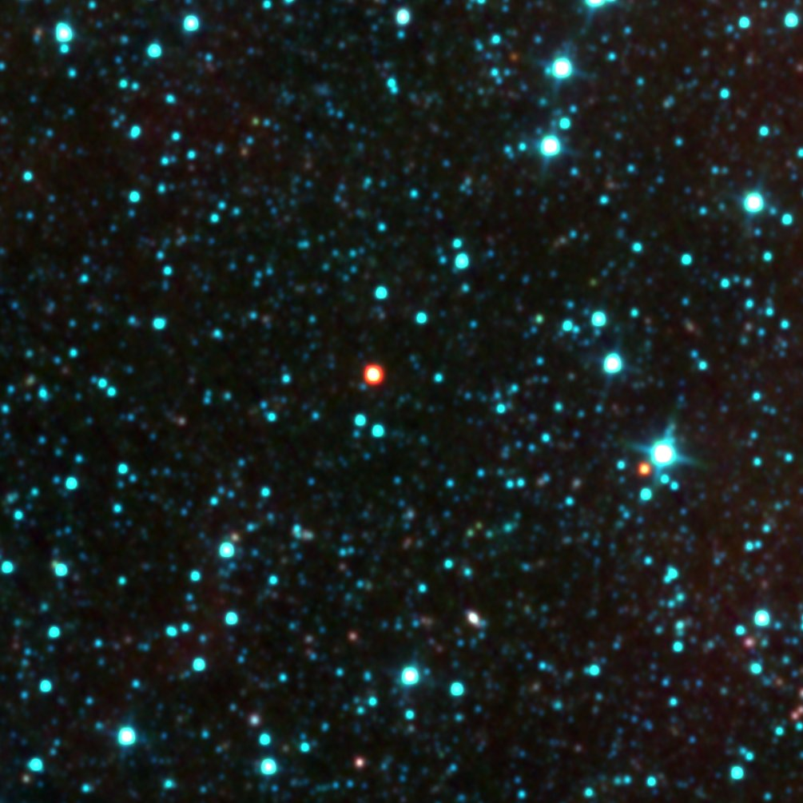
WISE color image
Light Detectives – #16
Notes:
This is a 3-color image, also known as an RGB image, created from the same 3 WISE images that the students just analyzed. W1 was assigned the color blue, W2 green, and W3 red. The images were then stacked on top of each other to create a color image.

Slide 17
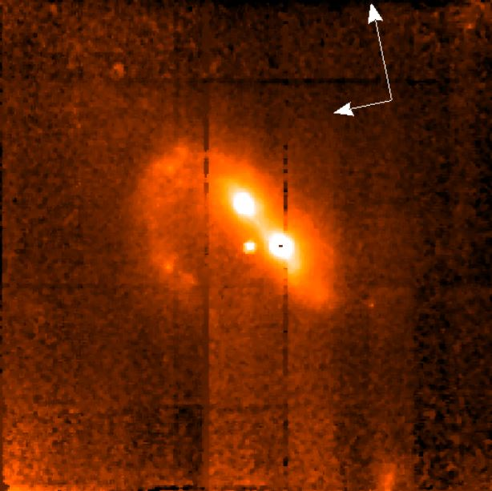
WISE color image
Hubble
image
ULIRG
created by two merging galaxies!
Light Detectives – #17
Notes:
Here is the same WISE image, along with a Hubble image of the ULIRG up close. The Hubble image shows that the object is in fact a ULIRG, which is created by two merging galaxies. It is one of the images that the students should have seen on the Hubble archive website, called N4GV12010. The image was taken by the Near Infrared Camera and Multi-Object Spectrometer (NICMOS) instrument, which looks at objects in the near-infrared wavelengths between 0.8 μm and 2.5 μm. So this Hubble image is in wavelengths longer than the human eye can see (0.39-0.7 μm), but shorter than what WISE can see (3.4-22 μm).
The arrows in the Hubble image point north and east.

