Slide 1
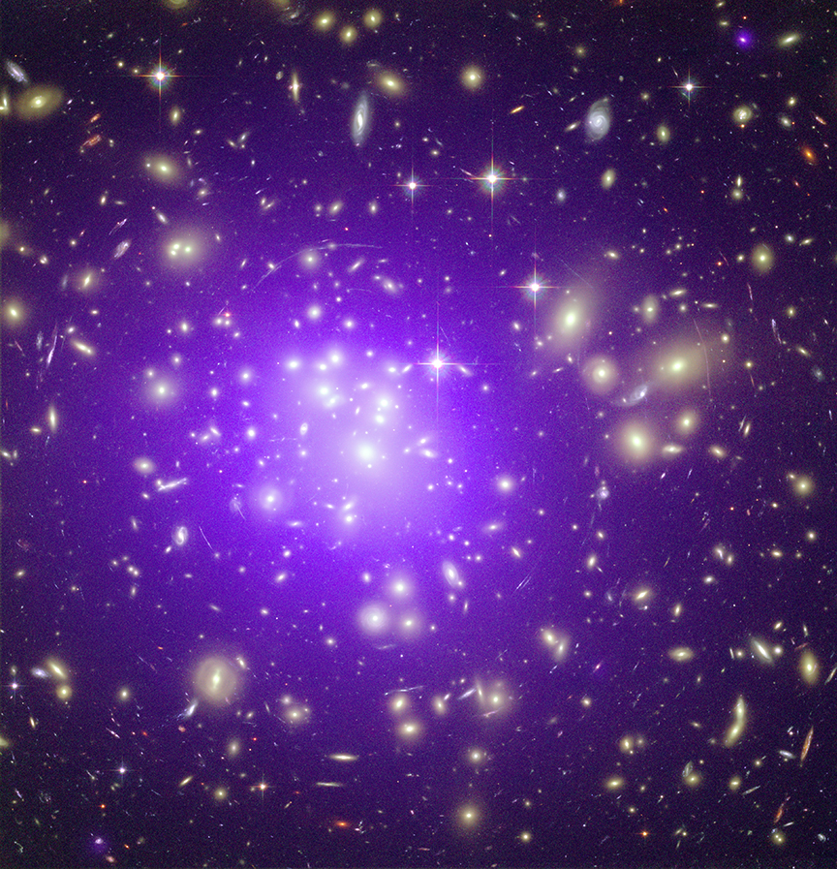
Title Slide
Size and Scale of the Universe
SIZE and Scale
Of The
Universe

Slide 2

What is your Cosmic Address?
Size and Scale of the Universe
# Street
City
State
Country
Continent
Hemisphere
Planet
Orbit
Star?
…?
…
…
…
…

Slide 3
Table for inputting guesses
Size and Scale of the Universe
Realm | Guesses
 | Group 1 | Group 2 | Group 3 | Group 4 | Group 5 | Group 6
Earth | Salt grain | Salt grain | Salt grain | Salt grain | Salt grain | Salt grain
Sun
Solar System
Solar Neighborhood
Galaxy
Local Group (of galaxies)
Local Supercluster (of galaxies)
Universe

Slide 4
Table of Answers
Size and Scale of the Universe
Realm | Actual Size (diameter in km) | Actual Size (in light-years) | Multiple “X” larger than Earth | Scale Model
Earth | 12,700 (1.27E+4) | 1.4 billionths (1.4E-9) | 1 | salt grain (0.1 mm)
Sun | 1.39 million (1.39E+6) | 1.5 ten-millionths (1.5E-7) | 109 (1.09E+2) | gum ball (1.09 cm)
Solar System | 30 billion (3.0E+10) | 0.0032 (3.2E-3) | 2.34 million (2.34E+6) | football stadium (234 meters)
Solar Neighborhood | 378 trillion (3.78E+14) | 40 (4.0E+1) | 30 billion (3.0E+10) | ~ size of Moon (3,480 km)
Galaxy | 946 quadrillion (9.46E+17) | 100,000 (1.0E+5) | 75 trillion (7.5E+13) | 5.4 Suns (7.5 million km)
Local Group (of galaxies) | 62 quintillion (6.15E+19) | 6.5 million (6.5E+6) | 4.8 quadrillion (4.8E+15) | orbit of Mars -diameter (~3 AU)
Local Supercluster | 1.2 sextillion (1.2E+21) | 130 million (1.3E+8) | 97 quadrillion (9.7E+16) | orbit of Neptune -diameter (~60 AU)
Universe | 860.9 sextillion (8.6E+23) | 91 billion (9.1E+10) | 68 quintillion (6.8E+19) | Oort Cloud-radius (48,000 AU or 0.76 ly)

Slide 5
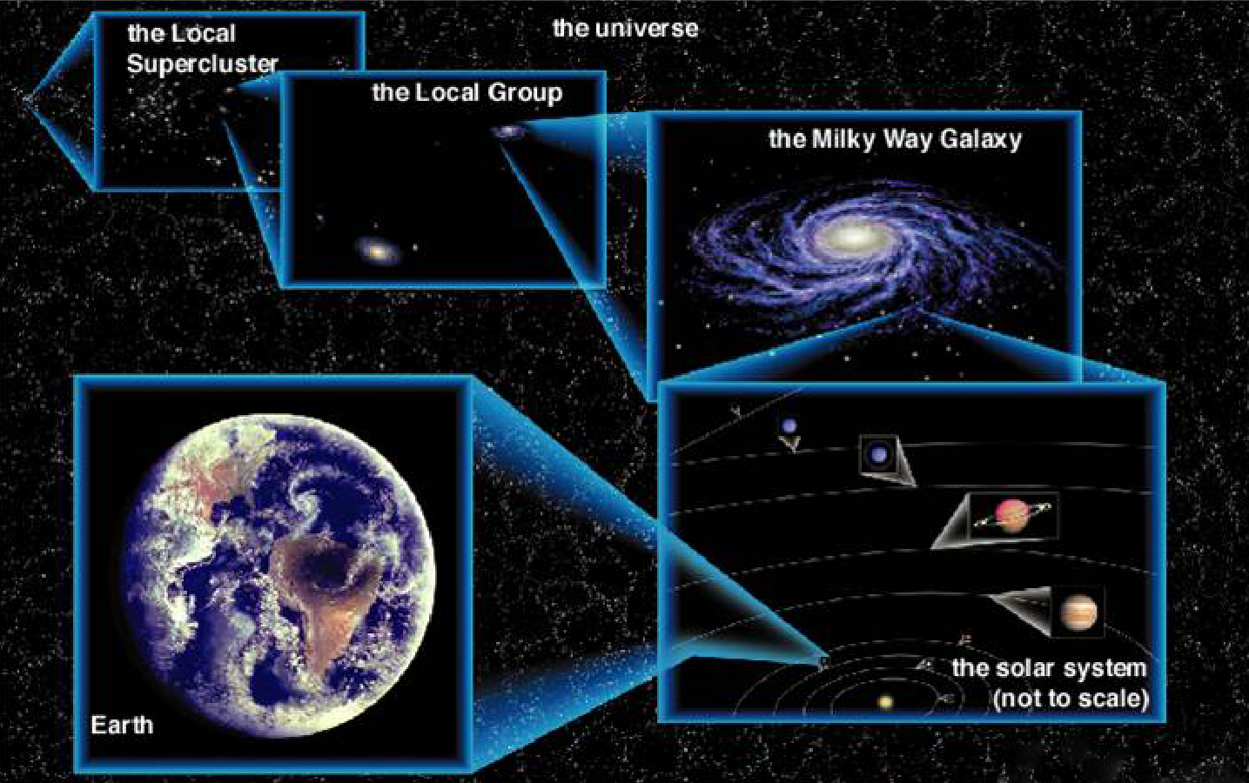
Realms of the Universe
Size and Scale of the Universe
Image courtesy of The Cosmic Perspective by Bennett, Donahue, Schneider, & Voit; Addison Wesley, 2002

Slide 6
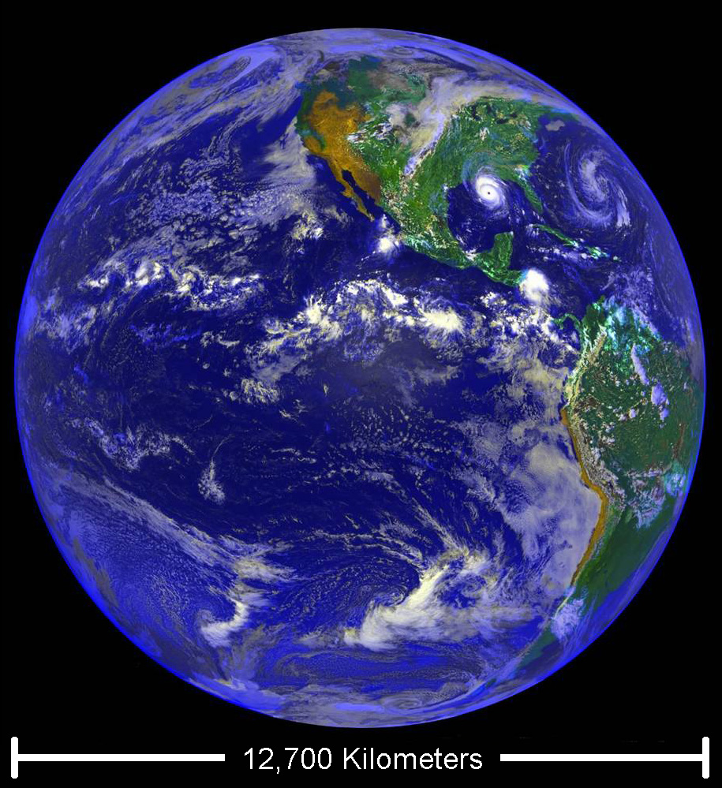
EARTH
Size and Scale of the Universe
Planet where we all live
Comprised primarily of rock
Spherical in shape
12,700 km in diameter
It would take 17 days to circumnavigate the globe driving a car at 100 km/hr (62 mph)
At the speed of light, it would take 0.13 seconds to go all the way around Earth
Image Credit: NASA/JPL/GSFC

Slide 7
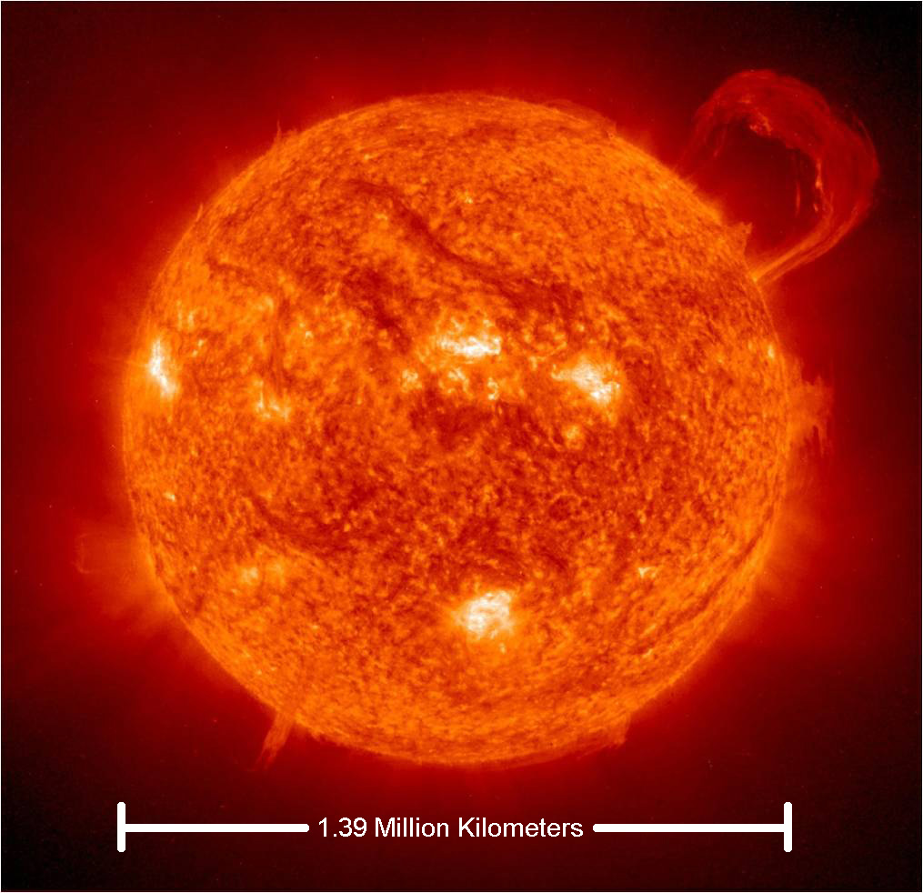
sun
Size and Scale of the Universe
The star that Earth orbits
Composed primarily of hydrogen and helium gas
Uses nuclear fusion in its core to generate heat and light to allow itself to resist the crushing weight of its own mass
Spherical in shape
1.39 Million km in diameter
Image Credit: SOHO/NASA/ESA

Slide 8
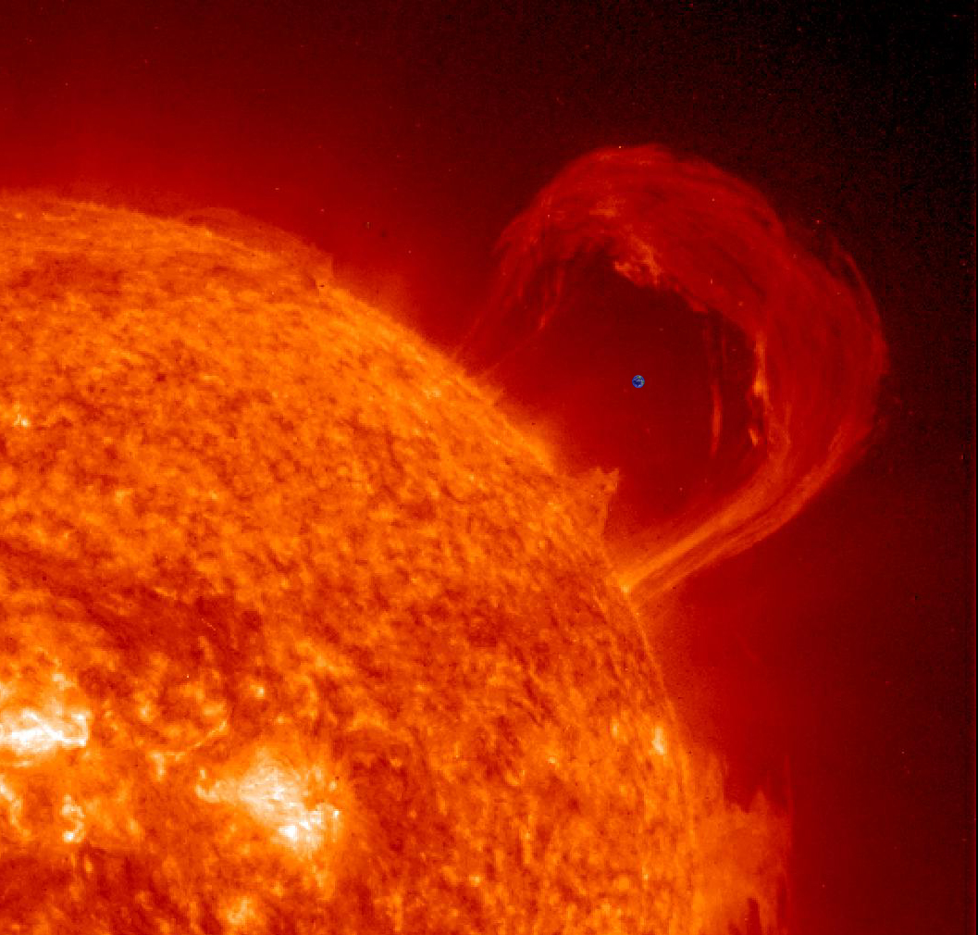
Sun & Earth
Size and Scale of the Universe
The Sun’s diameter is 109 times greater than that of Earth
Over 1 million Earths would fit inside the Sun’s volume
The average distance between the Earth and the Sun is called an Astronomical Unit (AU) - it is about150 million kilometers
It would take 11,780 Earths lined up side to side to bridge the gap between Earth and Sun (or 107 Suns)
Image Credit: SOHO/NASA/ESA

Slide 9
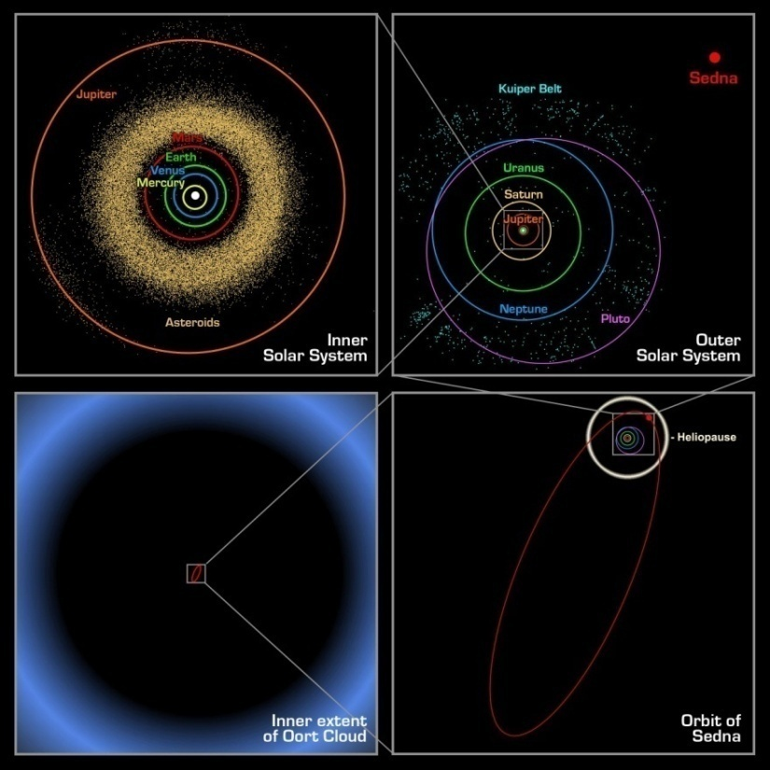
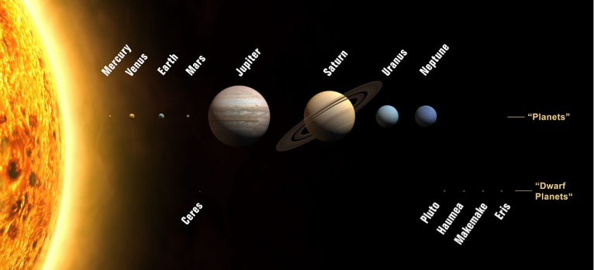
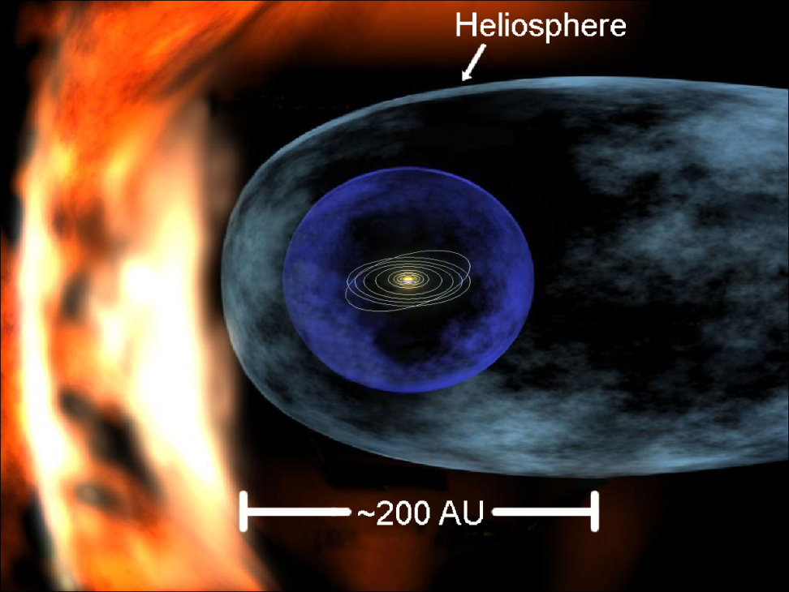
The Solar system
Size and Scale of the Universe
Image credit: NASA
8 planets, several dwarf planets, thousands of asteroids, and trillions of comets and meteoroids
Mostly distributed in a flat disk
Pluto orbits ~40 AU from Sun
Image credit: NASA/JPL-Caltech/R. Hurt
The Sun blows a constant wind of charged gas into interstellar space, called the Solar Wind
The boundary between the Solar Wind and interstellar space (the Heliosphere) is around 100 AU from the Sun (200 AU diameter)
Image credit: NASA

Slide 10
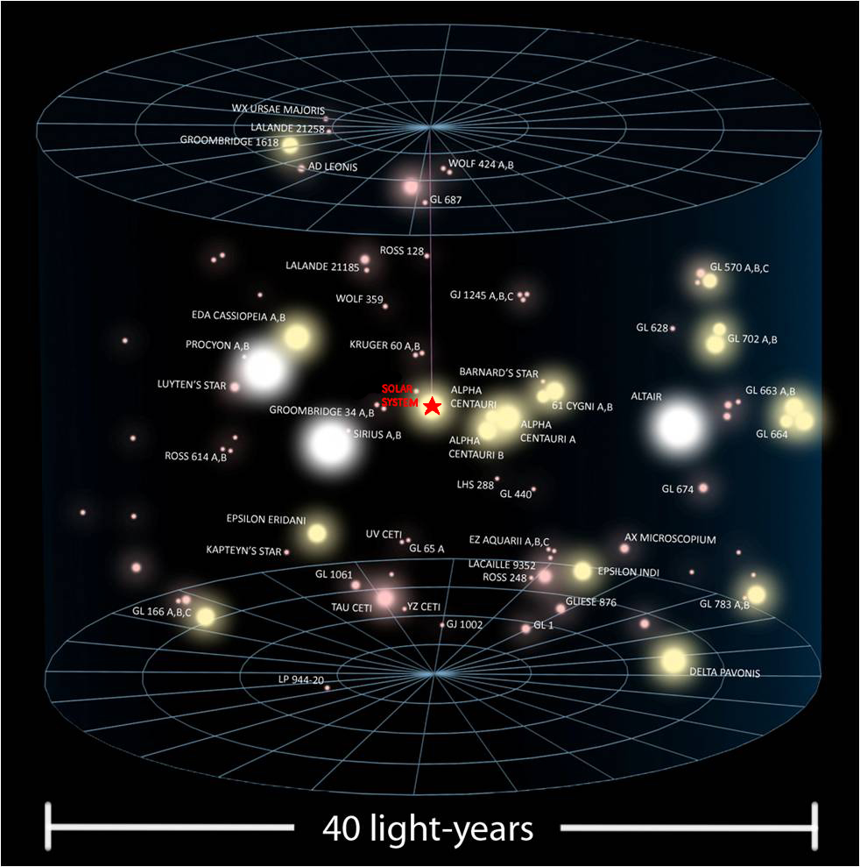
The Solar
Neighborhood
Size and Scale of the Universe
The region of the Galaxy within about 20 light-years of the Sun (40 light-years diameter)
A light-year is the distance that light travels in one year (~10 trillion kilometers or 63,000 AU)
The neighborhood stars generally move with the Sun in its orbit around the center of the Galaxy
The ‘Solar Neighborhood’ is a vague term not scientifically defined
Note: the size of the stars in this image represents their brightness, they would actually all be specks at this distance
Image credit: Andrew Colvin

Slide 11
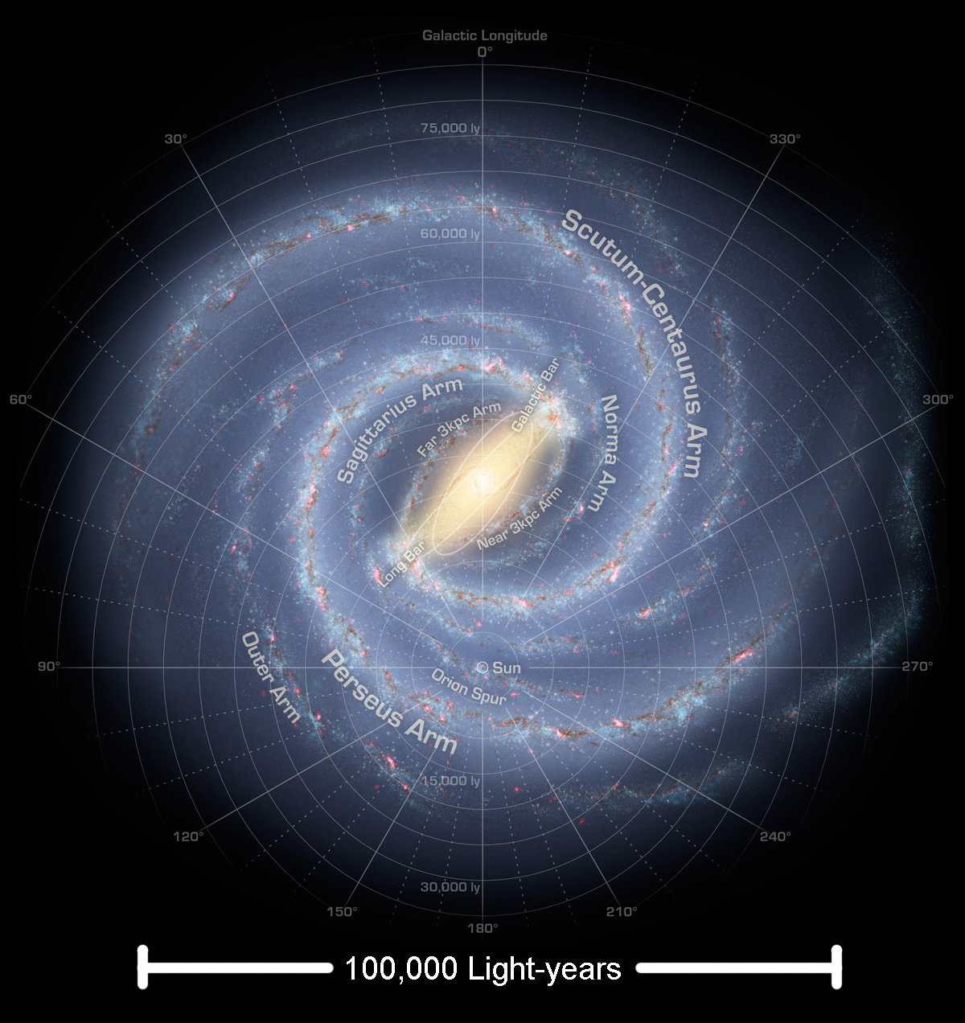
The Milky Way Galaxy
Size and Scale of the Universe
The Milky Way Galaxy is a giant disk of stars 100,000 light-years across and 1,000 light-years thick
The Sun is located at the edge of a spiral arm, 30,000 light-years from the center
It takes about 250 million years for the Sun to complete one orbit
There are over 200 billion stars in the Milky Way
Image credit: R. Hurt (SSC), JPL-Caltech, NASA

Slide 12
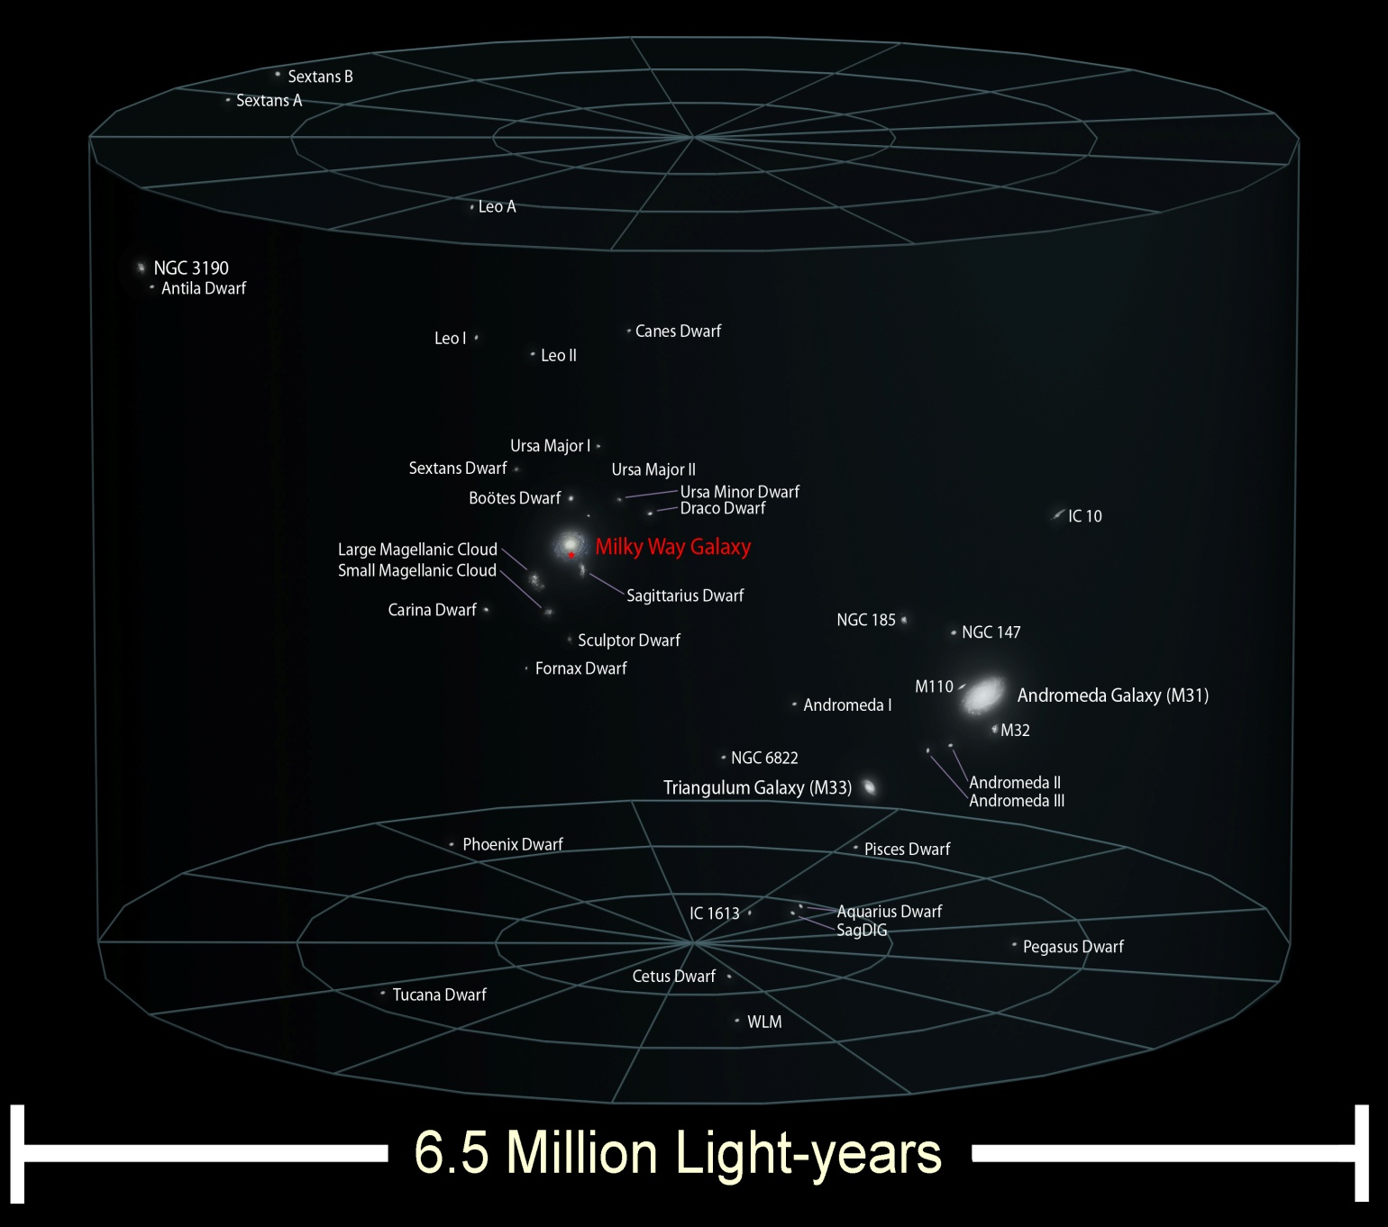
The Local Group
(of galaxies)
Size and Scale of the Universe
About 6.5 million light-years in diameter
Contains 3 large spiral galaxies -- Milky Way, Andromeda(M31), and Triangulum(M33) -- plus a few dozen dwarf galaxies with elliptical or irregular shapes
Gravitationally bound together—orbiting about a common center of mass
Roughly shaped like a football
Image Credit: Andrew Colvin

Slide 13
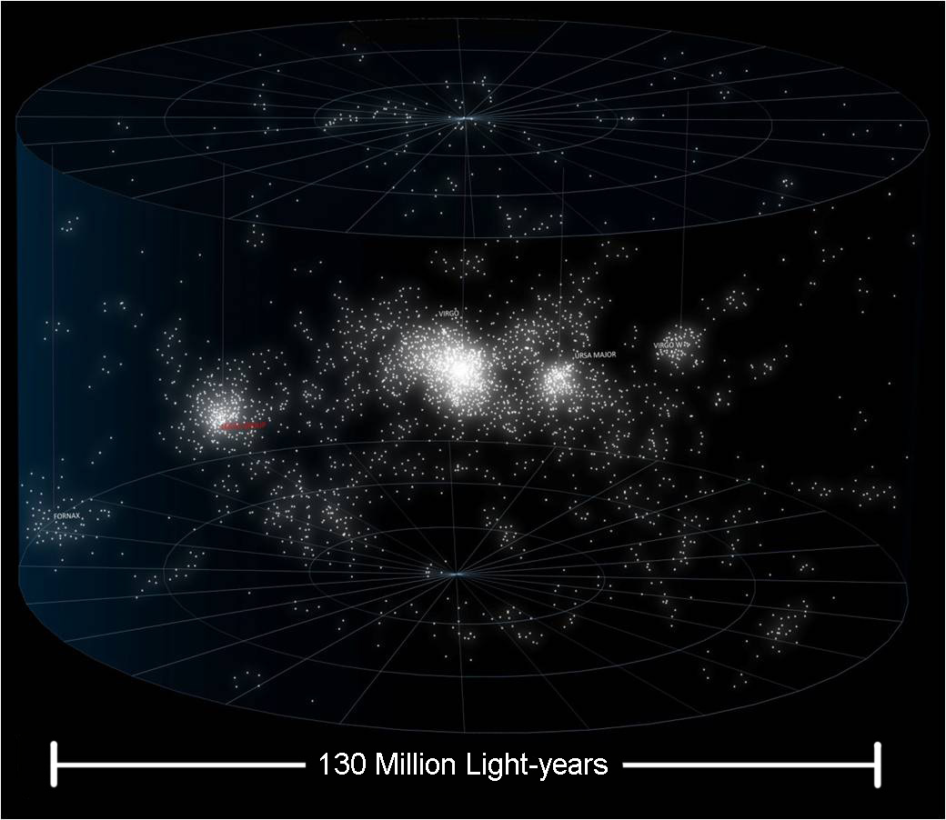
The Local Supercluster
Size and Scale of the Universe
The Local Supercluster is about 130 million light-years across
It’s a huge cluster of thousands upon thousands of galaxies
Largest cluster is the Virgo cluster containing well over a thousand galaxies
Clusters and groups of galaxies are gravitationally bound together, however the clusters and groups spread away from each other as the Universe expands
Roughly pancake shaped
Image credit: Andrew Colvin

Slide 14
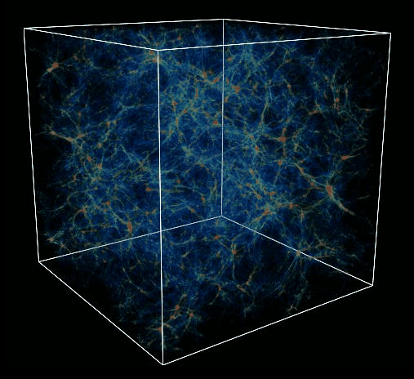
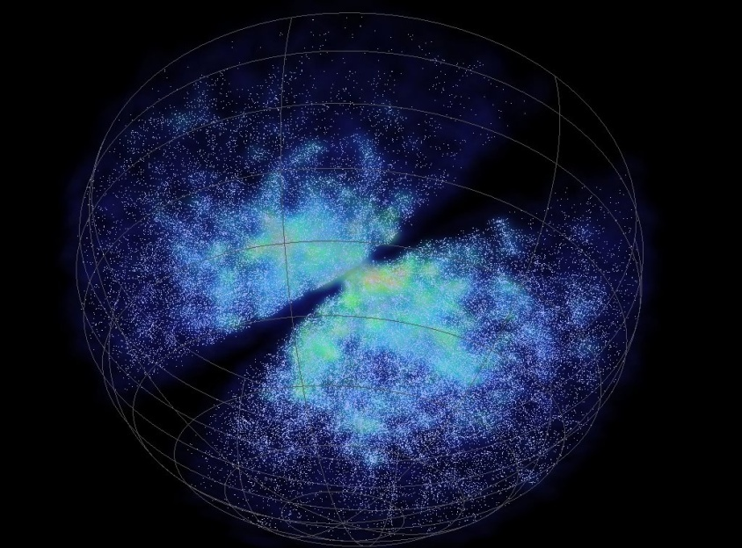
The Universe
(the observable portion)
Size and Scale of the Universe
Great walls and filaments of galaxy clusters surrounding voids containing no galaxies
Probably at least 100 billion galaxies in the Universe
Surveys of galaxies reveal a web-like or honeycomb structure to the Universe
Image Credit: G.L. Bryan, M. L. Norman, UIUC, NCSA, GC3
Computer simulations also show a similar structure, often called the “Cosmic Web”
Image Credit: Dr Chris Fluke, Centre for Astrophysics and Supercomputing, Swinburne University of Technology

Slide 15
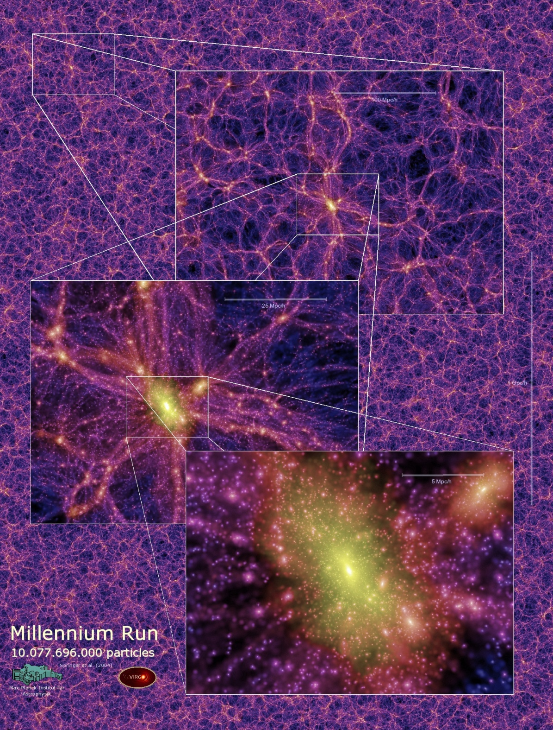
The Universe
(the observable portion)
Size and Scale of the Universe
The Observable Universe is currently about 91 billion light-years across
There could be (and likely is) much more beyond that, but we cannot see it from this point in spacetime
Note: The matter that we can see glowing shortly after the Big Bang (detected by the light it emitted 13.7 billion years ago) is now about 46 billion light-years away due to the ongoing expansion of the fabric of the Universe
Image Credit: Springer et al (2004)

Slide 16
So How do we know these distances?...
Size and Scale of the Universe

Slide 17
1) The Standard Rulers
Size and Scale of the Universe
There are two basic methods for measuring astronomical distances: the standard rulers and the standard candles...
Use knowledge of physical and/or geometric properties of an object to relate an angular size with a physical size to determine distance
Examples: Parallax, Moving Clusters, Time Delays, Water MASERs
Considered to be a direct or absolute measurement
R
d
θ
d = R/Tan(θ) ≅ R/θ

Slide 18
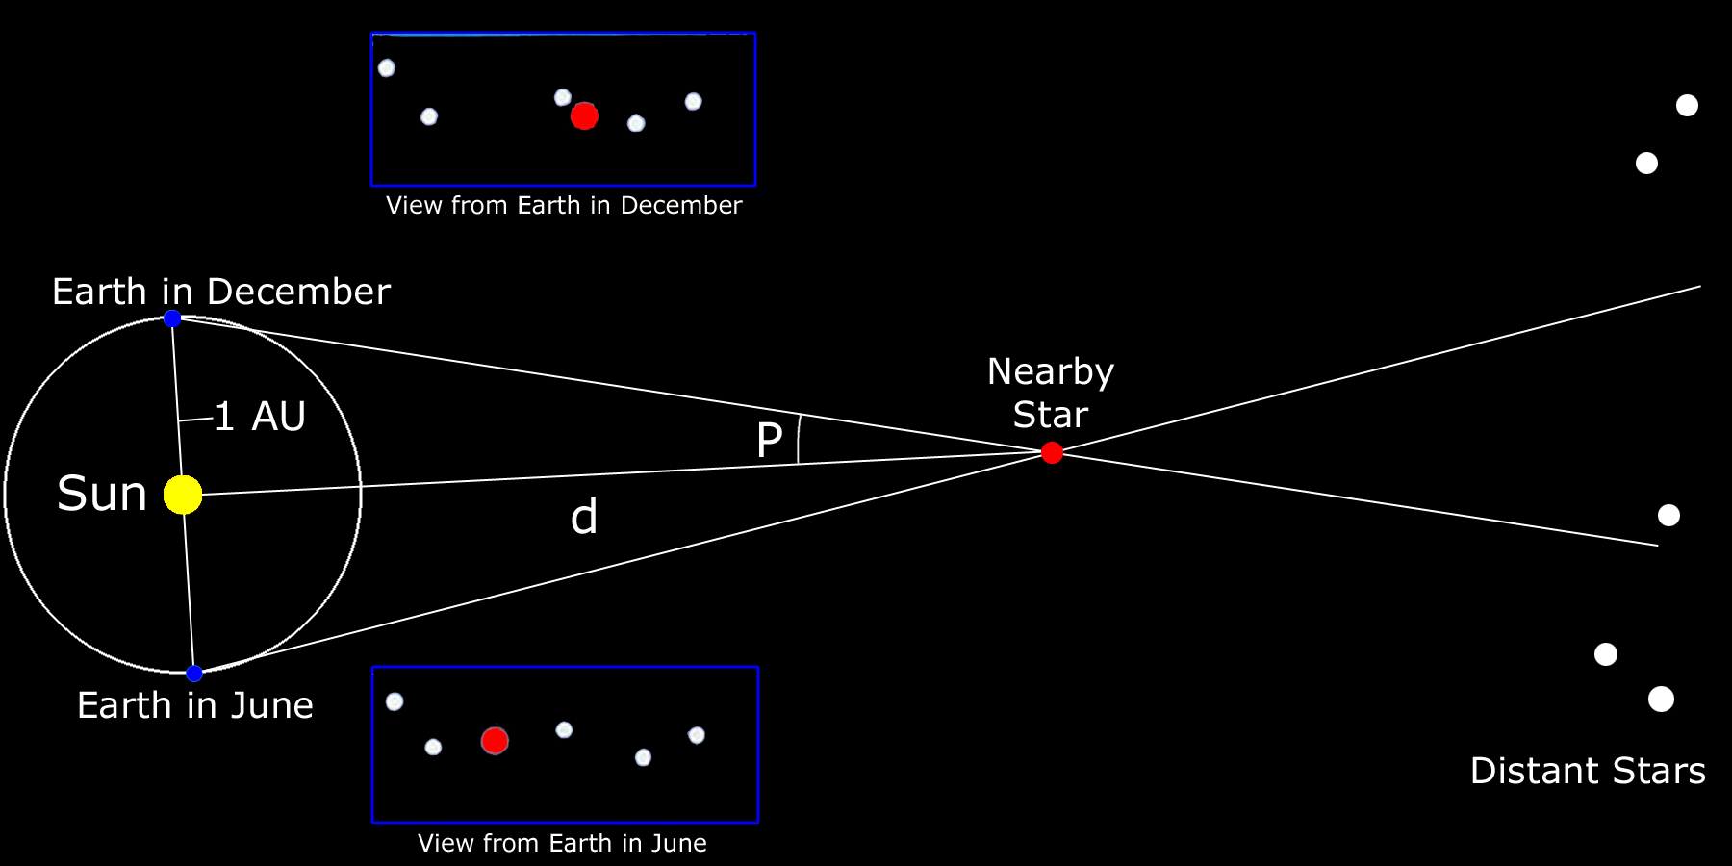
…Parallax
(a standard ruler)
Size and Scale of the Universe
Image Credit: B. Mendez
Requires very precise measurements of stellar positions, and long baselines
Need telescopes with high resolution, and must observe over several years
The Hipparchos satellite measured distances using this method for tens of thousands of stars within 1,500 light-years of the Sun

Slide 19
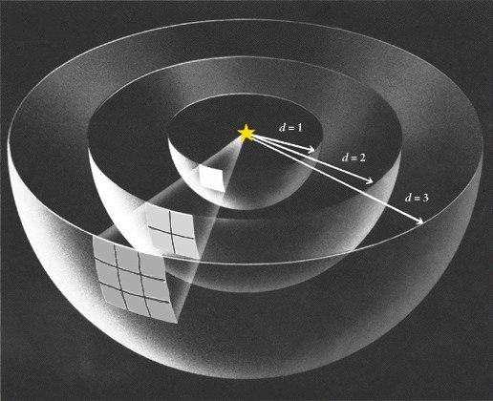
2) The Standard Candles
Size and Scale of the Universe
Use knowledge of physical and/or empirical properties of an object to determine its Luminosity, which yields distance via the Inverse Square Law of Light
Examples: Cepheid Variables, Supernovae, TRGB, Tully-Fisher
Considered to be relative until tied to an absolute calibration
b = L/4πd²
Image credit: Splung.com

Slide 20
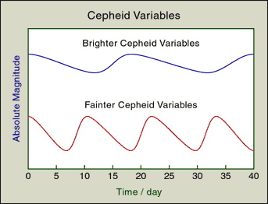
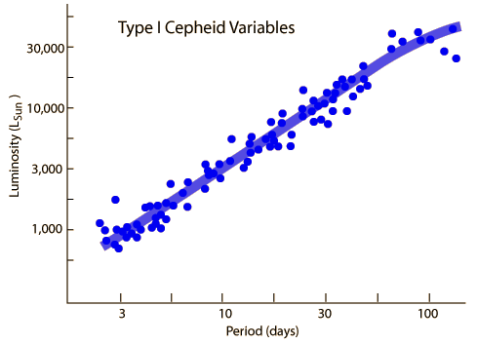
…Cepheid Variable Stars
(Standard Candles)
Size and Scale of the Universe
Cepheid Variables are a type of giant star whose surface pulsates in and out with a regular period. That Period of pulsation is related to the Luminosity of the star
Image credit: NASA
The Large Magellanic Cloud contains hundreds of Cepheids all at the same distance. Which allows for robust determination of the Period Luminosity Relationship
Image credit: NASA

Slide 21
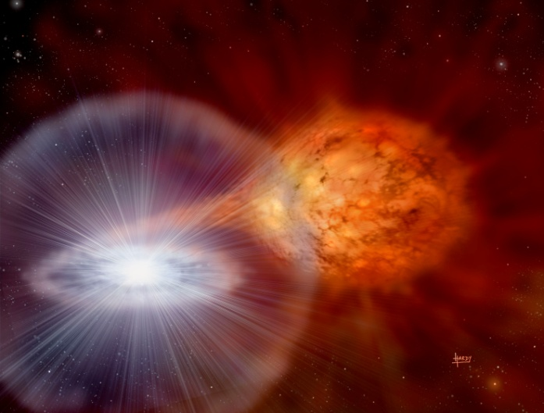
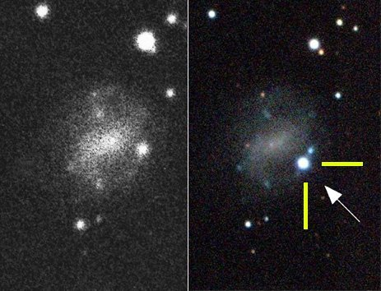
…Supernovae (Type 1a)
(Standard Candles)
Size and Scale of the Universe
Supernovae are EXTREMELY BRIGHT explosions that can be seen from enormous distances
Their absolute luminosity is known and fades at a consistent rate, so we can determine their distance
  Image credit: David Hardy, PPARC
White dwarfs capturing matter from a nearby star explode in special kind of Supernova called Type 1a
Type 1a supernovae are found by their spectral signature
Image credit: European Southern Observatory

Slide 22
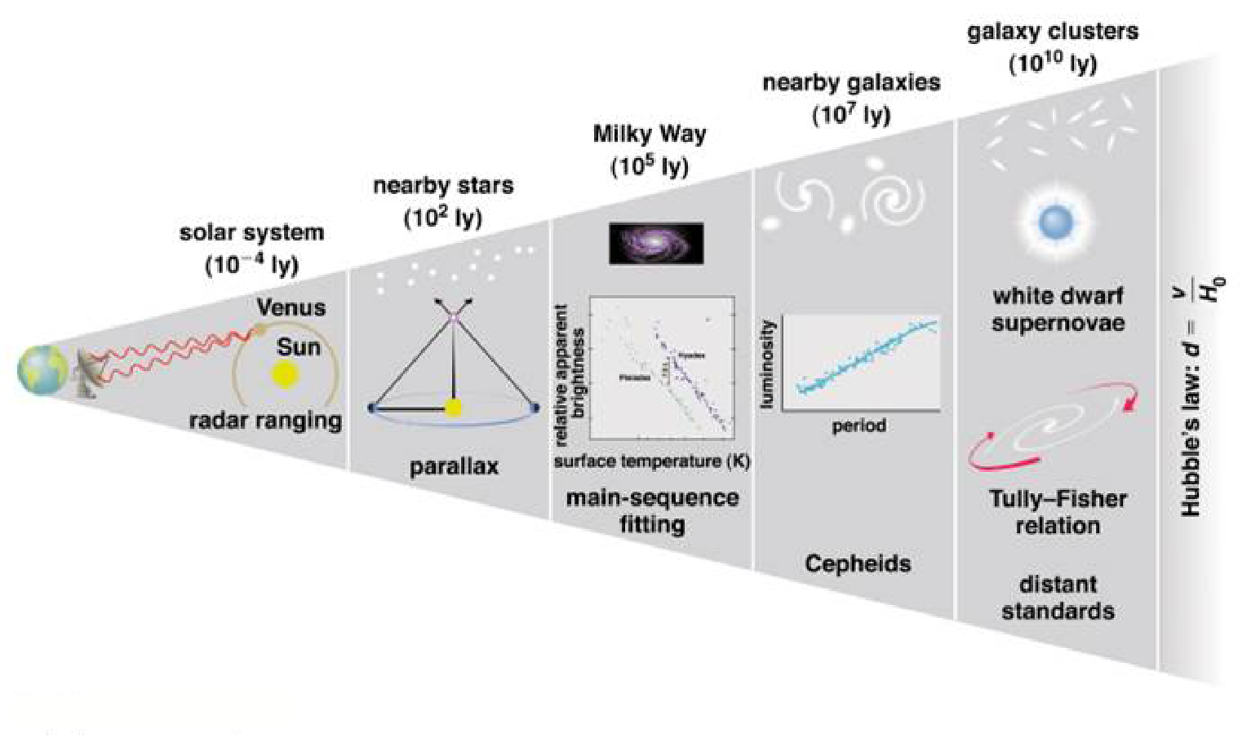
The Cosmic Ladder
Size and Scale of the Universe
To measure cosmological distances a ladder of methods is used to reach further
out into the Universe.
Each “rung” in the ladder depends
on the calibration of the methods “below” it.
Image credit: Addison Wesley

